Slide 1
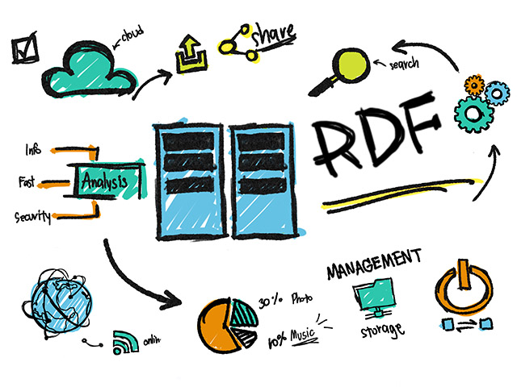
Mixing Music as Linked Data: SPARQL-based MIDI Mashups
Rick Meerwaldt1, Albert Meroño-Peñuela1, and Stefan Schlobach1 Department of Computer Science, Vrije Universiteit Amsterdam, NL
International Semantic Web Conference (ISWC) 2017
Notes:
semantic web
在網路上資料即是開放使用權
網路上的資料為機器可讀的資料
非專有的一個格式
資料要遵從RDF的標準
連結到其他RDF

Slide 2
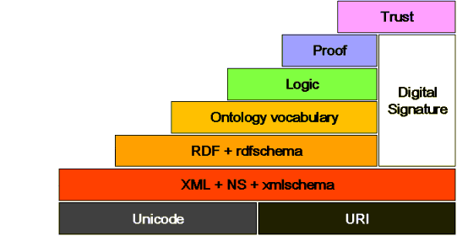
Semantic Web
Notes:
目的 :讓機器可以看
URI = URL + URN（Universal Resource Name），是指能夠識別出某項資源的名稱，比如說「Wikipedia」就是URN
Xml + NameSpace + Xmlschema：表現資料的內容與結構，無法表達機器可理解的語意
可以舉一下股票的例子

Slide 3
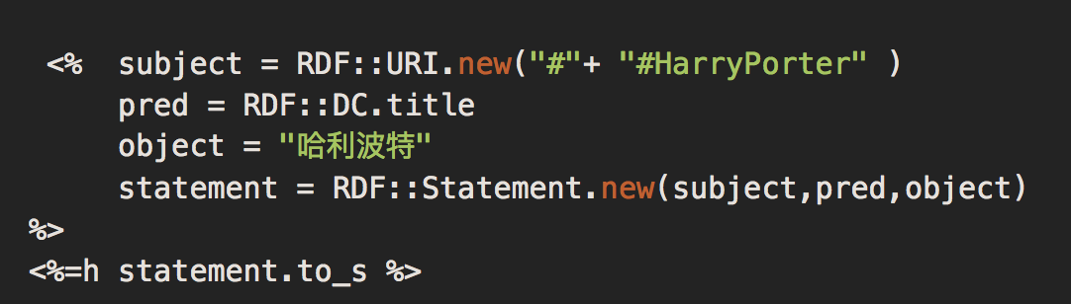
RDF(Resource Description Framework)
來源(Resources)：資料來源。
屬性(Properties)：描述來源的型別和其他屬性的關係。
敘述(Statements)：敘述的語句以RDF的格式表示。敘述被分成三個部分，分別是Subject、Predicate和Object。Subject可以表示來源，Predicate可以表示屬性，Object可以是文字或是其他的來源。
Notes:
W3c標準 Semantic web 語意網 ontolofy元數據
主詞 述詞 受詞
第一句的意思是我們現在有一個網址，命名為叫HarryPorter，而前面的"#"，我們可以想像就是平時在做網頁時設的錨點
第二句，我是以Dublin Core的"title"來描述HarryPorter，就是說HarryPorter是一個標題
第三句，它實際的敘述叫做“哈利波特"

Slide 4
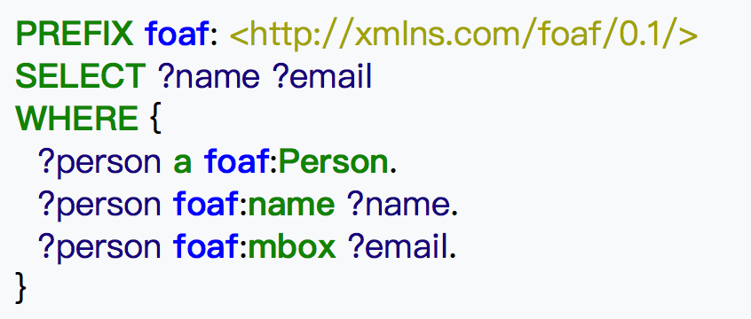
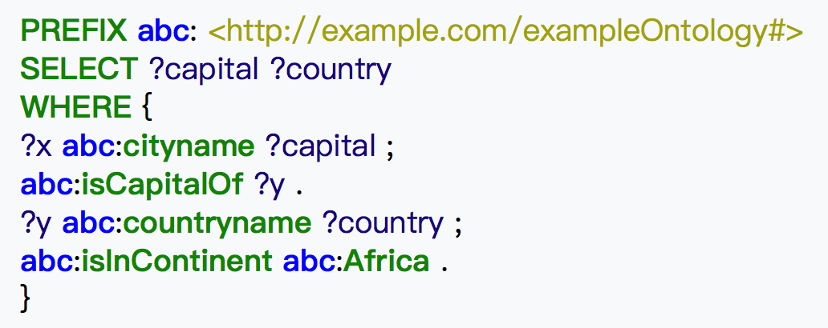
SPARQL (SPARQL Protocol and RDF Query Language)
Notes:
唸作sparkle w3c下的一個專門用於查詢RDF的標準

Slide 5
Contribution
A framework for the creative process of composing digital music mashups, fitting both MIDI and Linked Data best practices
A set of SPARQL query templates and queries to systematically find, filter, and select existing MIDI music represented as Linked Data, and blend them together as realistic mashups
SPARQL-DJ, an implementation that uses these SPARQL queries to auto- mate the process of creating MIDI mashups using MIDI Linked Data
no previous attempt has been made to compose digital music mashups by using only data and methods from the Semantic Web

Slide 6
Intro
Linked Open Data cloud, with large connected musical databases such as MusicBrainz, BBC Music and MySpace
A possible way of representing music as Linked Data is by converting digital music in MIDI format to RDF (MIDI2RDF)
When MIDI files are converted to RDF they can be shared on the Web as Linked Data, and queried at a fine-grained level using SPARQL.
no previous attempt has been made to compose digital music mashups by using only data and methods from the Semantic Web

Slide 7
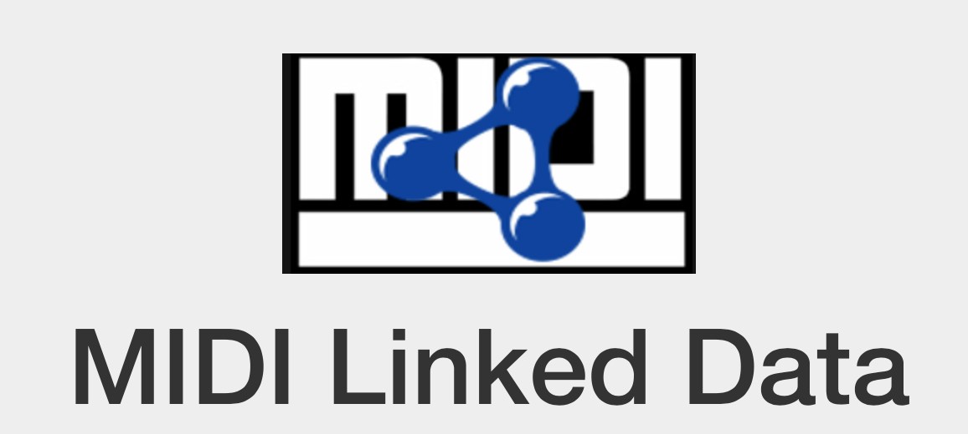
DataSet - MIDI Linked Data Cloud
The MIDI Linked Data Cloud connects 308,443 MIDI songs by representing their tracks, events, and notes as 10,215,557,355 RDF triples

Slide 8
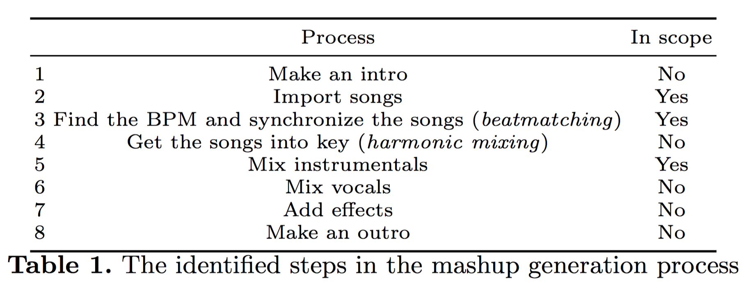
Mashup Process
Spin Academy, an online DJ school, the key skills to be mastered in order to make a mashup are beatmatching and mixing in key
Notes:
Focus在第三點 透過塞選歌曲 和樂器過濾
寫NO都是future work

Slide 9
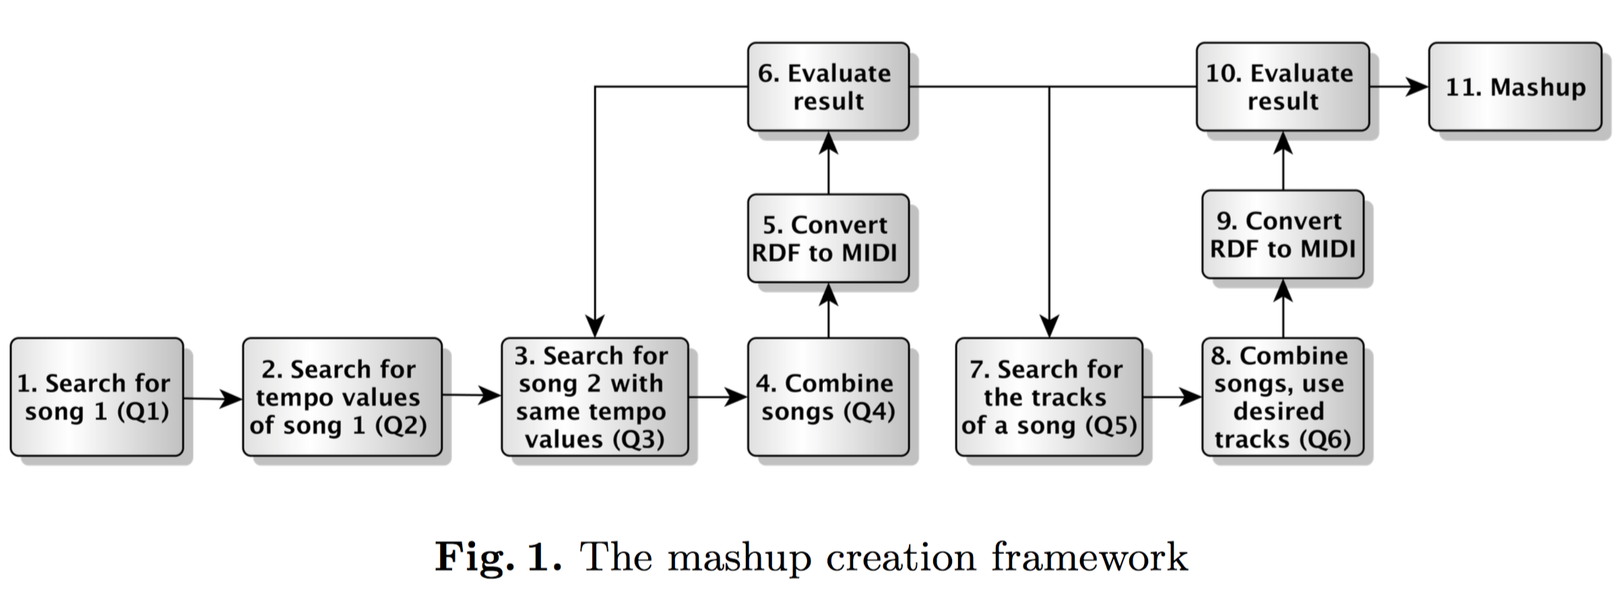
Framework

Slide 10
Implementation - beatmatching
The pattern of the first, second song
The tracks of the first, second pattern
1. Choose first pattern .Second pattern can be found by filtering on the tempo (resolution, numerator, denominator, metronome, and thirtyseconds) values of the first pattern
2. beats per minute (BPM) and the microseconds per quaternote (MPQN)
If these values are the same for both songs, they will automatically be beat-synchronous.
Notes:
Resolution - (the length of ticks)
numerator and denominator 一個小節可以用x個y分音符表示
Thirtyseconds 最小單位 需要多少個clock/ticks 來表示

Slide 11
Implementation – harmonic mixing
It is either possible to not use all tracks of both songs and to filter only on certain tracks .
However, if this does not work it is still possible to choose for a different second pattern

Slide 12
Discussion
do not provide for an automation of harmonic mixing
do not allow for the manipulation of the tempo values to make two songs beat-synchronous.
execution time was too high
queries are yet too expensive to be performed.
not all requirements from Table 1 are met

Slide 13
Conclusion
automatically manipulate the tempo values of two songs that are not beat-synchronous
harmonic matching
adding an intro, and outro, and the remaining phases
mixing MIDIs of the same/different genre
Notes:
future work？？
不同tempo的混合
和諧
加入 intro outro. . .
混合不同風格

